Slide 1


Bank of Baroda Hackathon - 2022
Technology Partner
Your Team Name : VADS
Your team bio :Stabbing action detection in ATM Kiosks– Academia (4 Members)
Research Interest: Video Analytics
Published Papers: 60
Industry Project Completed: 2
Date : 20.09.2022

Slide 2
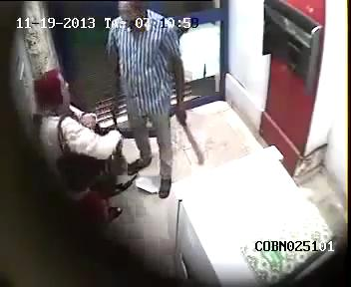
Problem Statement?
Why did you decide to solve this Problem statement?
The stabbing attack of a person most often occurs in
finance-based surveillance scenarios such as ATMs and
banks.
Similar incidents to such violent events happened in Bangalore ATM
(https://www.youtube.com/watch?v=anVFC81_mtc)
and China ATM (https://youtu.be/Yw-Apx06xrk).
Such incidents which frequently take place across the globe
mandate the necessity to take up a research on preventing such crimes and ensuring the safety of the public.
It is very challenging to detect such stabbing attacks in a restricted environment
like ATM.
Hence, the aim of the proposed system is to develop an intelligent video analytics for ATM surveillance applications for detecting the stabbing action happening inside the ATM.

Slide 3
User Segment & Pain Points
Which user /advertiser segment would be early adopter of your product & why?
Bank sectors (Public/Private)
Law and Order (Crime Investigation) – Evidence as well as alarm can be made at the right time.
Reason:
Customer safety is very important
Finance is also to be handled safely

Slide 4
Pre-Requisite
What are the alternatives/competitive products for the problem you are solving?
Securities are there. However, 24X7, this faciity is not available.
Inside the city, the control is possible. Areas beyond the city-limit, we can not monitor 24X7. Even the securities are attacked by the stabbers.
As per our knowledge, no surveillance products are there with the automated stabbing action alert system.
We have published one paper in CVIP 2020.
Research towards complex activities such as, a person stabbing with a knife, a person shooting with a Gun are budding.
Hybrid-based hierarchical approach for stabbing action detection has been proposed.

Slide 5
Azure tools or resources
Azure tools or resources which are likely to be used by you for the prototype, if your idea gets selected We have developed using Python. However, we can adopt the resources available for the prototype.

Slide 6
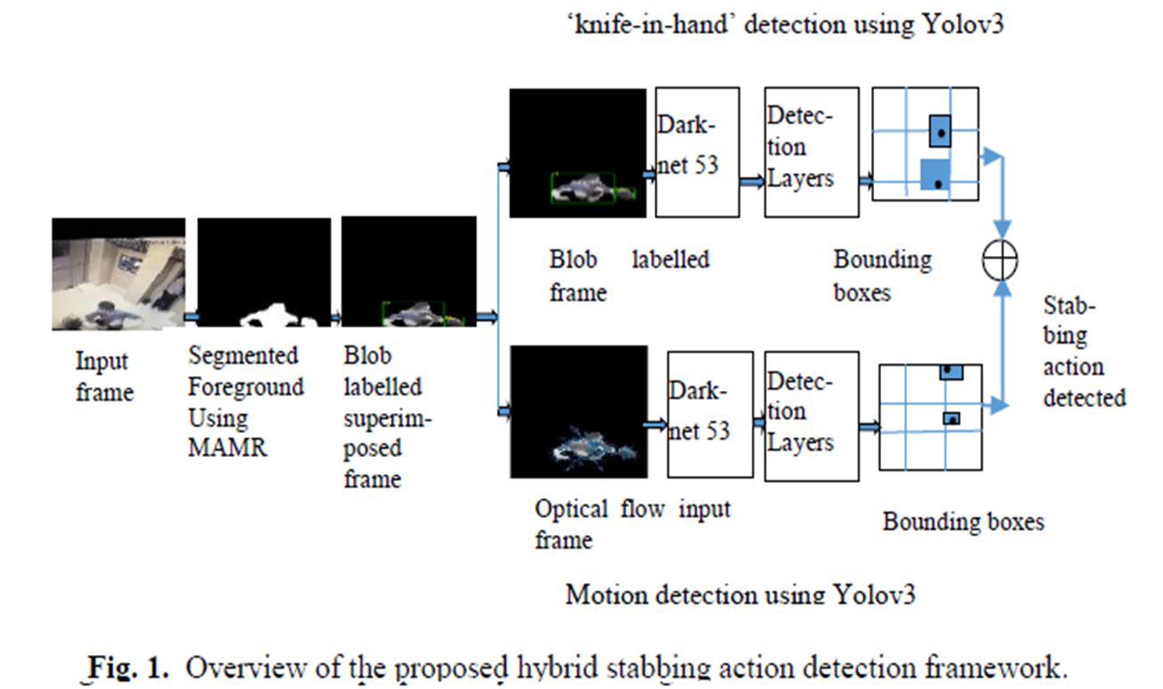
Any Supporting Functional Documents
Present your solution, talk about methodology, architecture & scalability

Slide 7
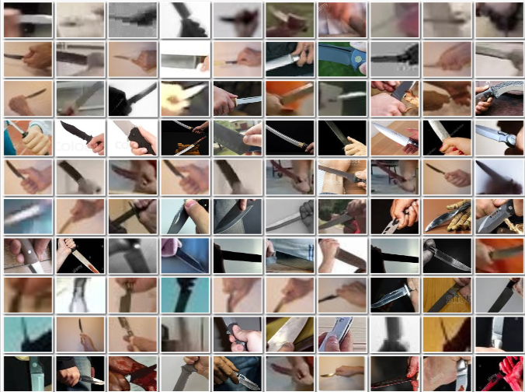
Fig. 2. Training images of ‘knife-in-hand’ acquired in challenging environments
Various Conditions | Training Images for knife in hand detection
Target (Blurred)
Targeting Left
Targeting Right
Targeting Obtuse
Targeting Obtuse (Blurred)
Targeting Reflex (Blurred)
Targeting Reflex
Targeting Downwards
Targeting Upwards
Target (Blur, Excess Blur and Normal)

Slide 8
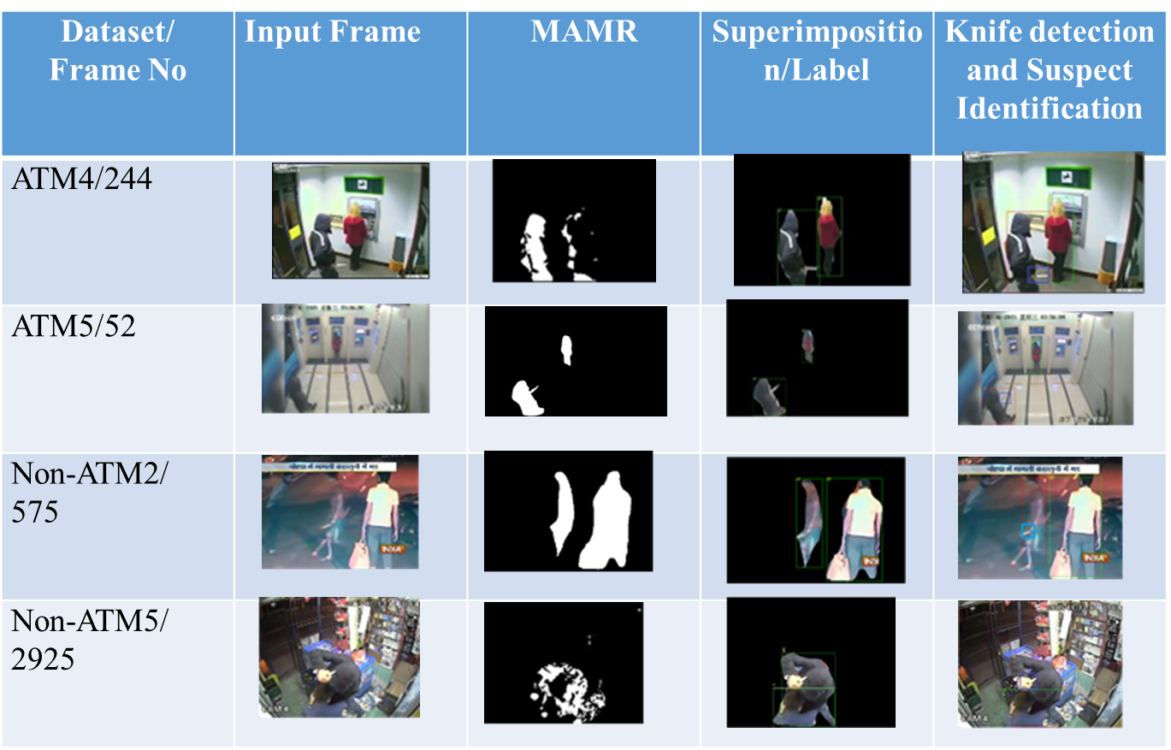

Slide 9
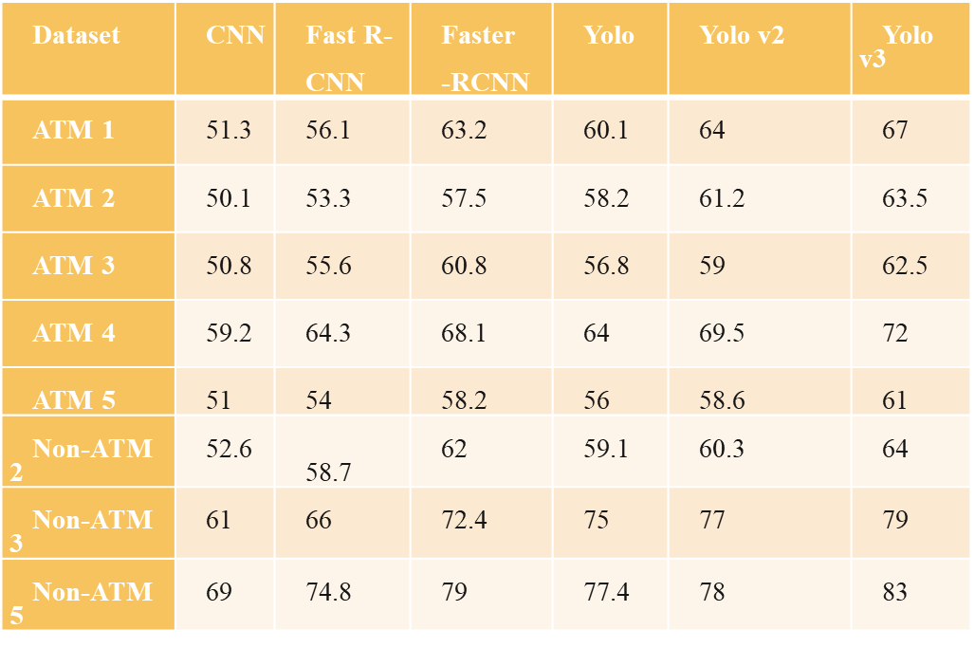
Table 2 mAP (%) of the ‘knife-in-hand’ detection using CNN, Fast R-CNN, Faster R-CNN(λ=10), Yolo, Yolo v2 and Yolo v3

Slide 10
It can be extended using YOLO v5 and YOLO v7 to improve the accuracy.
To reduce the false positives, we can improve the network architecture in each stage.

Slide 11
Stabbing Action Detection in ATM Kiosks

Slide 12
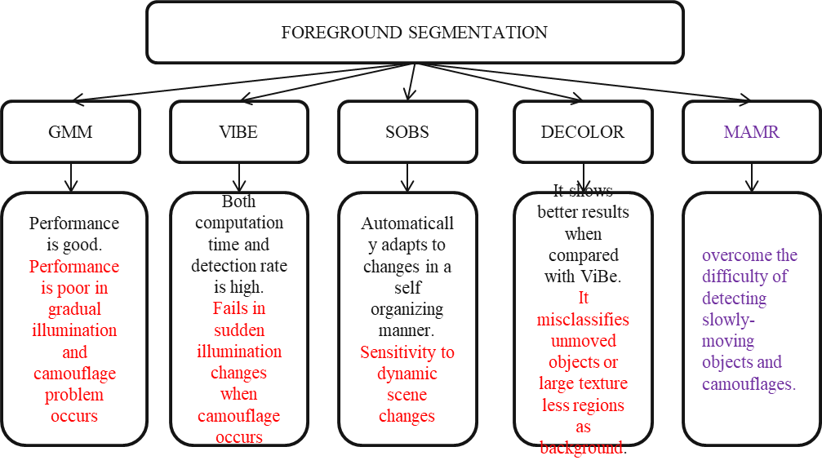
Key Differentiators & Adoption Plan
How is your solution better than alternatives and how do you plan to build adoption?

Slide 13
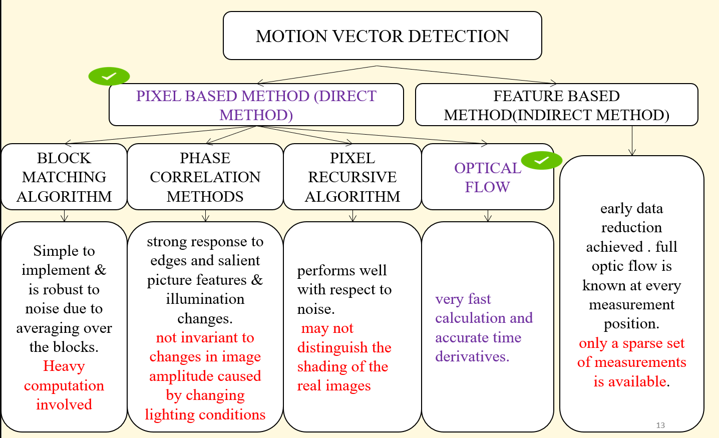

Slide 14
Table 3 Average mAP for stabbing action detection using WLD based TS concatenation framework and LK based TS concatenation
S.No | Dataset | LK based TS concatenation | WLD based TS concatenation
1 | ATM1 | 58 | 62
2 | ATM2 | 52 | 53
3 | ATM3 | 60 | 62.5
4 | ATM4 | 73 | 75
5 | ATM5 | 51 | 54
6 | Non-ATM 2 | 57 | 58
7 | Non-ATM 3 | 78 | 82
8 | Non-ATM 5 | 79 | 81

Slide 15
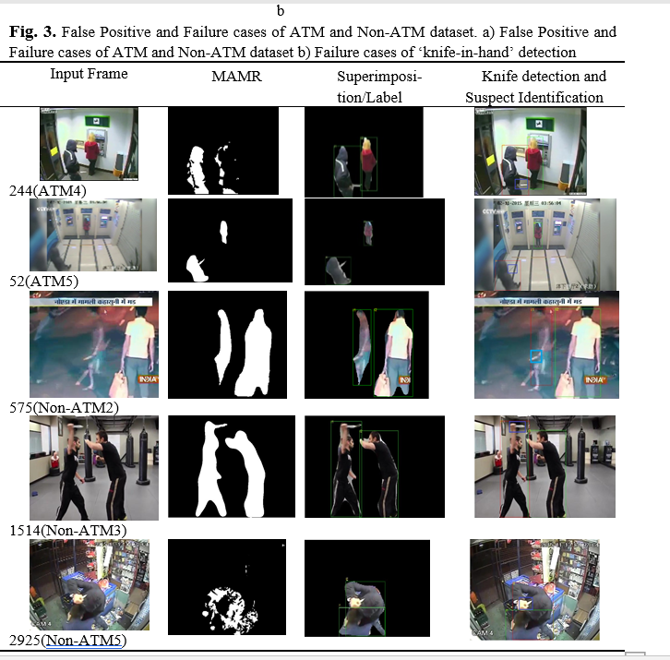
GitHub Repository Link & supporting diagrams, screenshots, if any
How far it can go?

Slide 16
Thank You
Team member names
Dr.B.Yogameena
Dr.K.Menaka
Ms. K.Iyshwarya Ratthi
Dr.S.Saravana Perumaal

